Slide 1
Best new features in
dotnet test, Microsoft.Testing.Platform & MSTest

Slide 2
01
dotnet test
& Microsoft.Testing.Platform

Slide 3
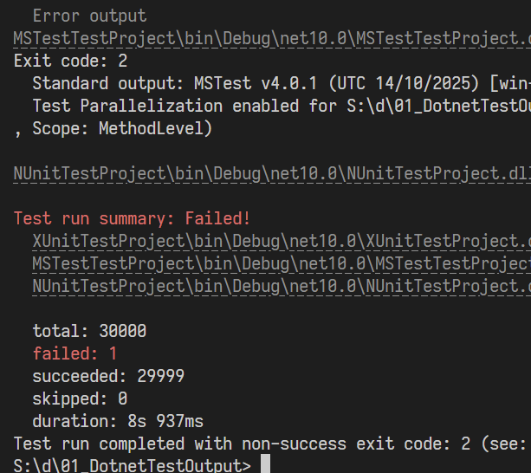

dotnet test
New UI & useful plugins.
See how to activate the new dotnet test mode, and use our Retry and AzureDevOps plugin.

Slide 4
Learn more
https://devblogs.microsoft.com/dotnet/dotnet-test-with-mtp/
https://aka.ms/testingplatform/extensions

Slide 5
02
MSTest

Slide 6
🎉 MSTest 4.0.0 is available on nuget.org
https://aka.ms/mstest/migration-v4

Slide 7
MSTest
Analyzers, Assertions and Attributes
See the best new things in MSTest.

Slide 8
Learn more
https://aka.ms/mstest/analyzers
https://aka.ms/mstest/migration-v4

Slide 9
03
Performance

Slide 10
Total time (in seconds)

Slide 11
Total memory allocations (in GB)

Slide 12
04
Summary

Slide 13

That's all
Please try our latest features.
We are looking for your feedback:
https://github.com/microsoft/testfx

Slide 14
Thank you

